Slide 1
Docker Intro v1

Slide 2
Agenda
What is docker and Key concepts
The Docker Platform
Getting start docker
Docker command
Docker build
Docker Network
Docker storage
Docker compose
What can use Docker for
Q/A

Slide 3
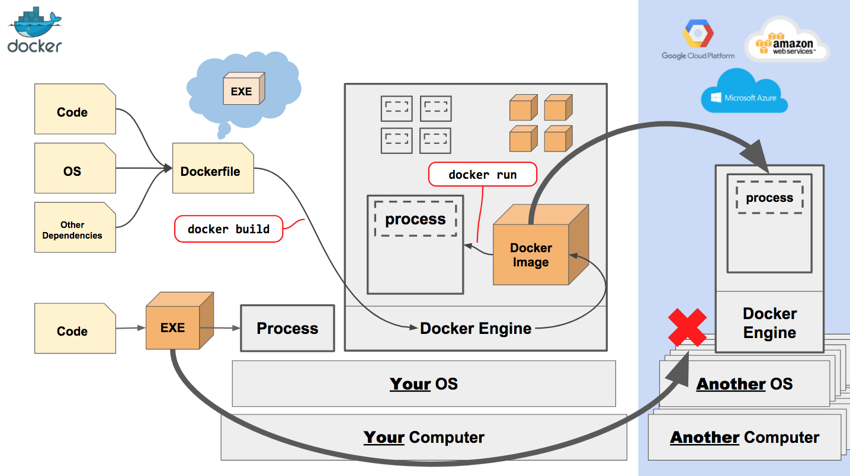
What is docker and Key concepts

Slide 4
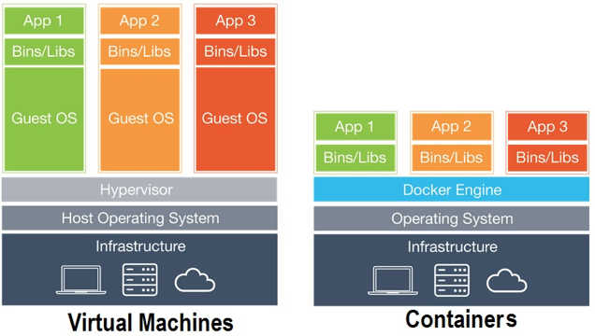
Containers vs Virtual Machines
Notes:
Advantages
The main advantages of Docker are:
Resource Efficiency: Process level isolation and usage of the container host’s kernel is more efficient when compared to virtualizing an entire hardware server.
Portability: All the dependencies for an application are bundled in the container. This means they can be easily moved between development, test, and production environments.
Continuous Deployment and Testing: The ability to have consistent environments and flexibility with patching has made Docker a great choice for teams that want to move from waterfall to the modern DevOps approach to software delivery.

Slide 5
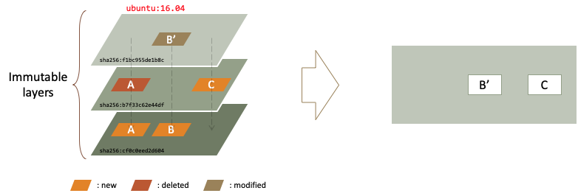
Docker layered file system

Slide 6
2. The Docker Platform
Tooling and a platform to manage the lifecycle of your containers:
Develop your application and its supporting components using containers.
The container becomes the unit for distributing and testing your application.
deploy your application into production environment, as a container or an orchestrated service. This works the same whether your production environment is a local data center, a cloud provider, or a hybrid of the two.
Notes:
Docker provides the ability to package and run an application in a loosely isolated environment called a container.
The isolation and security allow you to run many containers simultaneously on a given host.
Containers are lightweight because they don’t need the extra load of a hypervisor, but run directly within the host machine’s kernel.
This means you can run more containers on a given hardware combination than if you were using virtual machines. You can even run Docker containers within host machines that are actually virtual machines!

Slide 7
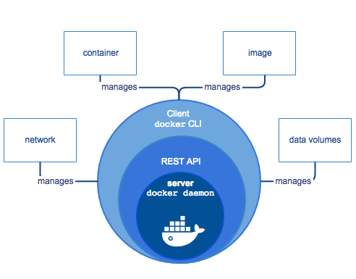
Docker Components
Docker daemon/ Docker engine
Images / Dockerfile
Containers
Docker command-line interface tools
Notes:
Docker Engine is a client-server application with these major components:
A server which is a type of long-running program called a daemon process (the dockerd command).
A REST API which specifies interfaces that programs can use to talk to the daemon and instruct it what to do.
A command line interface (CLI) client (the docker command).
Docker daemon is a thin layer between the containers and the Linux kernel. The Docker daemon is the persistent runtime environment that manages application containers. Any Docker container can run on any server that is Docker-daemon enabled, regardless of the underlying operating system
Dockerfile. Developers use Dockerfiles to build container images, which then become the basis of running containers. A Dockerfile is a text document that contains all of the configuration information and commands needed to assemble a container image. With a Dockerfile, the Docker daemon can automatically build a container image. This process greatly simplifies the steps for container creation.

Slide 8
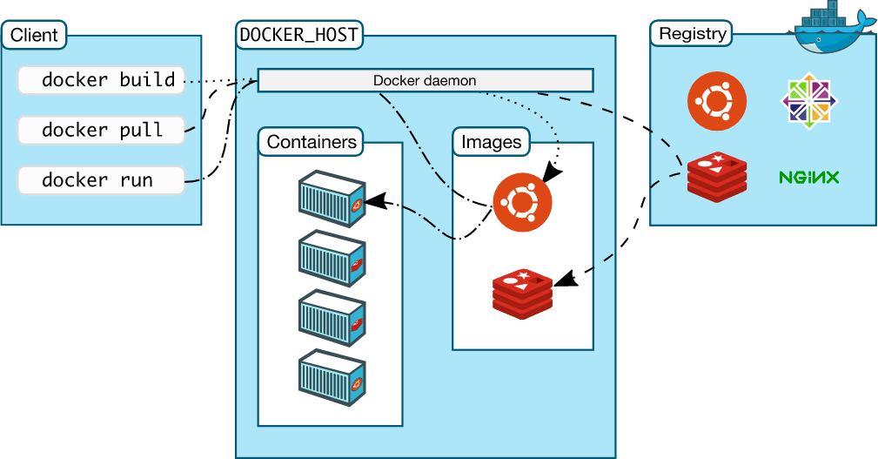
Docker architecture
Notes:
The Docker daemon
The Docker client
Docker registries
Docker objects
IMAGES
CONTAINERS
SERVICES

Slide 9
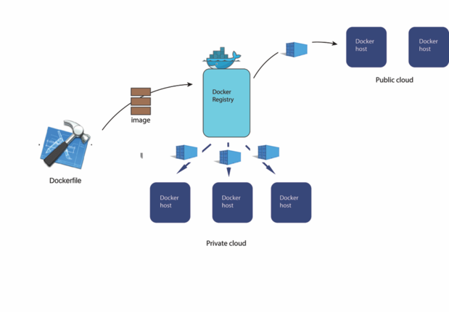
Content distribution with docker
Registry
a place where container images are published and stored
Docker Hub
public, cloud-based container registry managed by Docker
provides image discovery, distribution, and collaboration workflow support
Notes:
Registry. A Docker registry is a place where container images are published and stored. A registry can be remote or on premises. It can be public, so everyone can use it, or private, restricted to an organization or a set of users. A Docker registry comes with a set of common APIs that allow users to build, publish, search, download, and manage container images.
Docker Hub. Docker Hub is a public, cloud-based container registry managed by Docker. Docker Hub provides image discovery, distribution, and collaboration workflow support. In addition, Docker Hub has a set of official images that are certified by Docker. These are images from known software publishers such as Canonical, Red Hat, and MongoDB. You can use these official images as a basis for building your own images or applications.

Slide 10
3. Getting start docker
Install docker
Start docker container

Slide 11
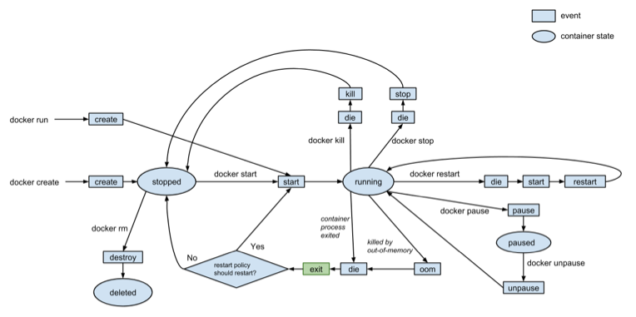
Container lifecycle

Slide 12
4. Docker command
Docker Hub
Image and Container Information
Work With Images and Containers
Image Creation

Slide 13
Docker Hub
Docker Syntax | Description
docker search searchterm | Search Docker Hub for images.
docker pull user/image | Downloads an image from Docker Hub.
docker login | Authenticate to Docker Hub (or other Docker registry).
docker push user/image | Uploads an image to Docker Hub. You must be authenticated to run this command.

Slide 14
Image and Container Information
Docker Syntax | Description
docker ps | List all running containers.
docker ps -a | List all container instances, with their ID and status.
docker images | Lists all images on the local machine.
docker history user/image | Lists the history of an image.
docker logs [container name or ID] | Displays the logs from a running container.
docker port [container name or ID] | Displays the exposed port of a running container.
docker diff [container name or ID] | Lists the changes made to a container.

Slide 15
Work With Images and Containers
Docker Syntax | Description
docker run -it user/image | Runs an image, creating a container and changing the terminal to the terminal within the container.
docker run -p $HOSTPORT:$CONTAINERPORT -d user/image | Run an image in detached mode with port forwarding.
ctrl+p then ctrl+q | From within the container’s command prompt, detach and return to the host’s prompt.
docker attach [container name or ID] | Changes the command prompt from the host to a running container.
docker start [container name or ID] | Start a container.
docker stop [container name or ID] | Stop a container.
docker rm -f [container name or ID] | Delete a container.
docker rmi | Delete an image.
docker tag user/image:tag user/image:newtag | Add a new tag to an image.
docker exec [container name or ID] shell command | Executes a command within a running container.

Slide 16
Image Creation
Docker Syntax | Description
docker commit user/image | Save a container as an image.
docker save user/image | Save an image to a tar archive.
docker build -t sampleuser/ubuntu . | Builds a Docker image from a Dockerfile in the current directory.
docker load | Loads an image from file.

Slide 17
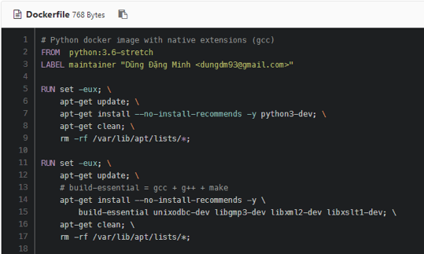
Docker builds
Dockerfile
Debugging broken Docker builds

Slide 18
Docker Networks
iptables rules on Linux / routing rules on Windows servers
Network drivers
Bridge: The default network driver
host: For standalone containers, remove network isolation between the container and the Docker host
overlay: Overlay networks connect multiple Docker daemons together and enable swarm services to communicate with each other
macvlan: Macvlan networks allow you to assign a MAC address to a container, making it appear as a physical device on your network
none: For this container, disable all networking
Network plugins: You can install and use third-party network plugins with Docker
Notes:
User-defined bridge networks are best when you need multiple containers to communicate on the same Docker host.
Host networks are best when the network stack should not be isolated from the Docker host, but you want other aspects of the container to be isolated.
Overlay networks are best when you need containers running on different Docker hosts to communicate, or when multiple applications work together using swarm services.
Macvlan networks are best when you are migrating from a VM setup or need your containers to look like physical hosts on your network, each with a unique MAC address.
Third-party network plugins allow you to integrate Docker with specialized network stacks.

Slide 19
Docker Networks
Bridge network:
docker network ls
docker network inspect bridge
docker network create --driver bridge alpine-net
docker run -dit --name alpine1 --network alpine-net alpine ash
docker network inspect alpine-net
Host network:
docker run --rm -d --network host --name my_nginx nginx
Tools
docker run -it --net container:<container_name> nicolaka/netshoot
docker run --rm --hostname dns.mageddo -v /var/run/docker.sock:/var/run/docker.sock -v /etc/resolv.conf:/etc/resolv.conf defreitas/dns-proxy-server
Notes:
User-defined bridge networks are best when you need multiple containers to communicate on the same Docker host.
Host networks are best when the network stack should not be isolated from the Docker host, but you want other aspects of the container to be isolated.
Overlay networks are best when you need containers running on different Docker hosts to communicate, or when multiple applications work together using swarm services.
Macvlan networks are best when you are migrating from a VM setup or need your containers to look like physical hosts on your network, each with a unique MAC address.
Third-party network plugins allow you to integrate Docker with specialized network stacks.

Slide 20
Docker Storage
Storage Drivers
docker info
sudo docker run –d –volume-driver=flocker –v /home/demo:/var/jenkins_home –p 8080:8080 –p 50000:50000 jenkins
Technology | Storage Driver
OverlayFS | overlay or overlay2
AUFS | aufs
Btrfs | brtfs
Device Manager | devicemanager
VFS | vfs
ZFS | zfs
Notes:
AUFS
This is a stable driver; can be used for production-ready applications.
It has good memory usage and is good for ensuring a smooth Docker experience for containers.
There is a high-write activity associated with this driver which should be considered.
It’s good for systems which are of Platform as a service type work.
Devicemapper
This is a stable driver; ensures a smooth Docker experience.
This driver is good for testing applications in the lab.
This driver is in line with the main Linux kernel functionality.
Btrfs
This driver is in line with the main Linux kernel functionality.
There is a high-write activity associated with this driver which should be considered.
This driver is good for instances where you maintain multiple build pools.
Ovelay
This is a stable driver and it is in line with the main Linux kernel functionality.
It has a good memory usage.
This driver is good for testing applications in the lab.
ZFS
This is a stable driver and it is good for testing applications in the lab.
It’s good for systems which are of Platform-as-a-Service type work.

Slide 21
Docker Storage
Data Volumes
They are initialized when the container is created.
They can be shared and also reused amongst many containers.
Any changes to the volume itself can be made directly.
They exist even after the container is deleted.
CMD
docker volume ls
docker volume create –-name=volumename –-opt options
Notes:
features of data volume:

Slide 22
Docker compose
Run multiple containers as a single service
Features:
Multiple isolated environments on a single host
Preserve volume data when containers are created
Only recreate containers that have changed
Variables and moving a composition between environments

Slide 23
Docker compose
Get started with Docker Compose:
Install docker engine / docker compose
Setup
Create a dockerfile
Create compose file
Build and run app with compose
Edit the Compose file to add a bind mount
Re-build and run the app with Compose
Update the application

Slide 24
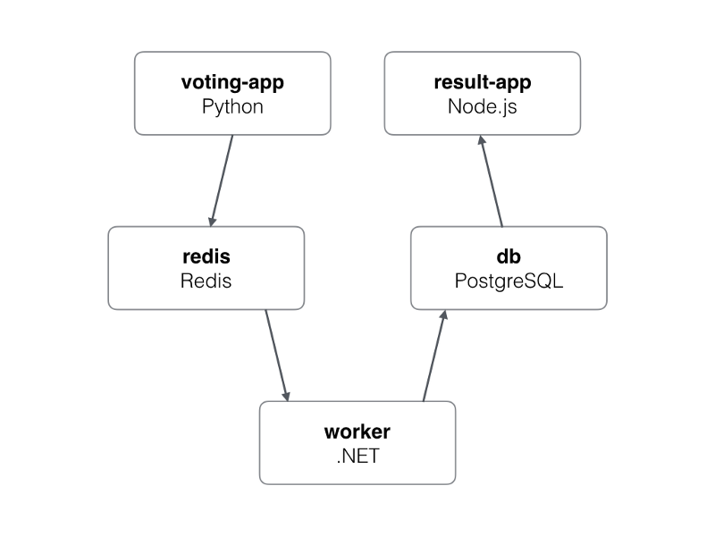
Docker compose example
version: "3"
 | services:
 | vote:
 | build: ./vote
 | command: python app.py
 | volumes:
 | - ./vote:/app
 | ports:
 | - "5000:80"
 | networks:
 | - front-tier
 | - back-tier
 | result:
 | build: ./result
 | command: nodemon server.js
 | volumes:
 | - ./result:/app
 | ports:
 | - "5001:80"
 | - "5858:5858"
 | networks:
 | - front-tier
 | - back-tier
 | worker:
 | build:
 | context: ./worker
 | depends_on:
 | - "redis"
 | networks:
 | - back-tier
 | redis:
 | image: redis:alpine
 | container_name: redis
 | ports: ["6379"]
 | networks:
 | - back-tier
 | db:
 | image: postgres:9.4
 | container_name: db
 | volumes:
 | - "db-data:/var/lib/postgresql/data"
 | networks:
 | - back-tier
 | volumes:
 | db-data:
 | networks:
 | front-tier:
 | back-tier:

Slide 25
Docker compose Cheat sheet
docker-compose up -d
docker-compose down
docker-compose start
docker-compose stop
docker-compose build
docker-compose logs -f db
docker-compose scale db=4
docker-compose events
docker-compose exec db bash

Slide 26
What can use Docker for
Fast, consistent delivery of applications
CI/CD pipeline: Build - Test - Deploy
Responsive deployment and scaling
Running more workloads on the same hardware

